Slide 1
An Introductory on
MATLAB and Simulink
KLOGO, Griffith Selorm
selormklogo@gmail.com
COE 387

Slide 2
Introduction to
MATLAB and Simulink
What can you gain from the course ?
Know what MATLAB/Simulink is
Know how to get started with MATLAB/Simulink
Know basics of MATLAB/Simulink
– know how to solve simple problems
  Be able to explore MATLAB/Simulink on your own !

Slide 3
Introduction to
MATLAB and Simulink
Contents
Introduction
Getting Started
Vectors and Matrices
MATLAB
Built in functions
M–files : script and functions
Simulink
Modeling examples
SIMULINK

Slide 4
Introduction
MATLAB – MATrix LABoratory
  Initially developed by a lecturer in 1970’s to help students learn linear algebra.
  It was later marketed and further developed under MathWorks Inc. (founded in 1984) – www.mathworks.com
  Matlab is a software package which can be used to perform analysis and solve mathematical and engineering problems.
  It has excellent programming features and graphics capability – easy to learn and flexible.
  Available in many operating systems – Windows, Macintosh, Unix, DOS
  It has several tooboxes to solve specific problems.

Slide 5
Introduction
Simulink
  Used to model, analyze and simulate dynamic systems using block diagrams.
  Fully integrated with MATLAB , easy and fast to learn and flexible.
  It has comprehensive block library which can be used to simulate linear, non–linear or discrete systems – excellent research tools.
  C codes can be generated from Simulink models for embedded applications and rapid prototyping of control systems.

Slide 6
Getting Started
Run MATLAB from Start → Programs → MATLAB
Depending on version used, several windows appear
  For example in Release 13 (Ver 6), there are several windows – command history, command, workspace, etc
  For Matlab Student – only command window
Command window
Main window – where commands are entered

Slide 7
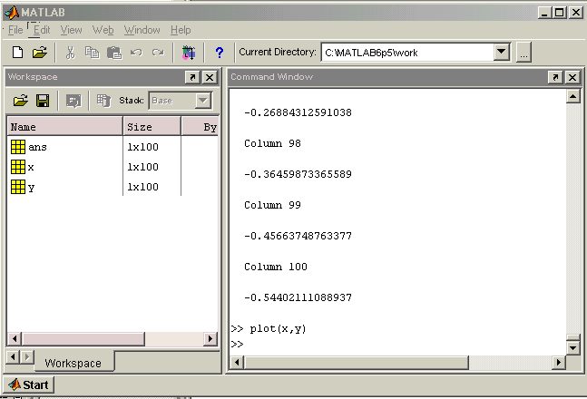
Example of MATLAB Release 13 desktop

Slide 8


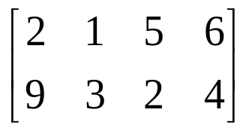

Variables
– Vectors and Matrices –
ALL variables are matrices
e.g. 1 x 1 4 x 1 1 x 4 2 x 4
Variables
They are case–sensitive i.e x ≠ X
Their names can contain up to 31 characters
Must start with a letter
Variables are stored in workspace

Slide 9
Vectors and Matrices
How do we assign a value to a variable?
>>> v1=3
v1 =
3
>>> i1=4
i1 =
4
>>> R=v1/i1
R =
0.7500
>>>
>>> whos
Name Size Bytes Class
R 1x1 8 double array
i1 1x1 8 double array
v1 1x1 8 double array
Grand total is 3 elements using 24 bytes
>>> who
Your variables are:
R i1 v1
>>>

Slide 10
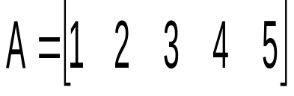
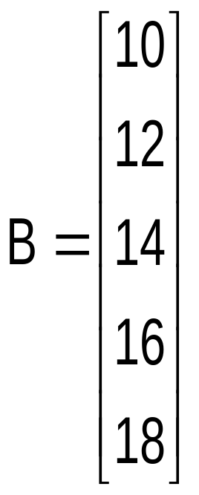
Vectors and Matrices
How do we assign values to vectors?
A row vector – values are separated by spaces
>>> A = [1 2 3 4 5]
A =
1 2 3 4 5
>>>
>>> B = [10;12;14;16;18]
B =
10
12
14
16
18
>>>
A column vector – values are separated by semi–colon (;)

Slide 11
Vectors and Matrices
How do we assign values to vectors?
If we want to construct a vector of, say, 100 elements between 0 and 2π – linspace
>>> c1 = linspace(0,(2*pi),100);
>>> whos
Name Size Bytes Class
c1 1x100 800 double array
Grand total is 100 elements using 800 bytes
>>>

Slide 12
Vectors and Matrices
How do we assign values to vectors?
If we want to construct an array of, say, 100 elements between 0 and 2π – colon notation
>>> c2 = (0:0.0201:2)*pi;
>>> whos
Name Size Bytes Class
c1 1x100 800 double array
c2 1x100 800 double array
Grand total is 200 elements using 1600 bytes
>>>

Slide 13
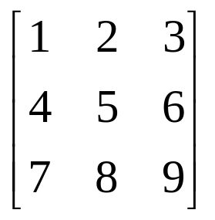
Vectors and Matrices
How do we assign values to matrices ?
>>> A=[1 2 3;4 5 6;7 8 9]
A =
1 2 3
4 5 6
7 8 9
>>>
Columns separated by space or a comma
Rows separated by semi-colon

Slide 14
Vectors and Matrices
How do we access elements in a matrix or a vector?
Try the followings:
>>> A(2,3)
ans =
6
>>> A(:,3)
ans =
3
6
9
>>> A(2,:)
ans =
4 5 6
>>> A(1,:)
ans =
1 2 3

Slide 15

Vectors and Matrices
Some special variables
beep
pi (π)
inf (e.g. 1/0)
i, j ( )
>>> 1/0
Warning: Divide by zero.
ans =
Inf
>>> pi
ans =
3.1416
>>> i
ans =
0+ 1.0000i

Slide 16
Vectors and Matrices
Arithmetic operations – Matrices
Performing operations to every entry in a matrix
>>> A=[1 2 3;4 5 6;7 8 9]
A =
1 2 3
4 5 6
7 8 9
>>>
Add and subtract
>>> A+3
ans =
4 5 6
7 8 9
10 11 12
>>> A-2
ans =
-1 0 1
2 3 4
5 6 7

Slide 17
Vectors and Matrices
Arithmetic operations – Matrices
Performing operations to every entry in a matrix
>>> A=[1 2 3;4 5 6;7 8 9]
A =
1 2 3
4 5 6
7 8 9
>>>
Multiply and divide
>>> A*2
ans =
2 4 6
8 10 12
14 16 18
>>> A/3
ans =
0.3333 0.6667 1.0000
1.3333 1.6667 2.0000
2.3333 2.6667 3.0000

Slide 18
Vectors and Matrices
Arithmetic operations – Matrices
Performing operations to every entry in a matrix
Power
>>> A=[1 2 3;4 5 6;7 8 9]
A =
1 2 3
4 5 6
7 8 9
>>>
To square every element in A, use the element–wise operator .^
>>> A.^2
ans =
1 4 9
16 25 36
49 64 81
>>> A^2
ans =
30 36 42
66 81 96
102 126 150
A^2 = A * A

Slide 19
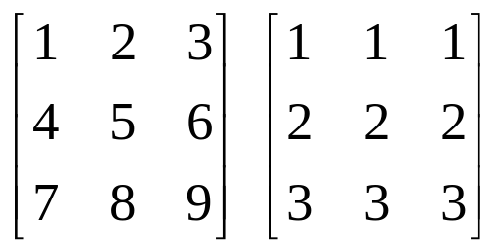
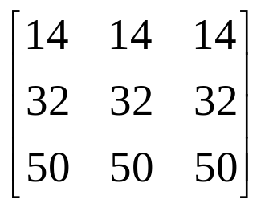
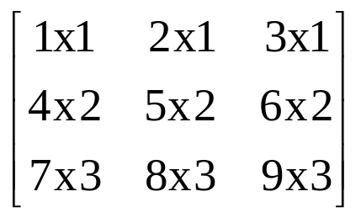
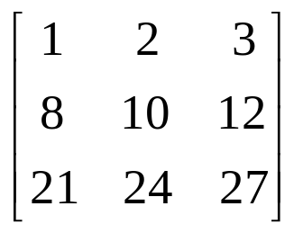
Vectors and Matrices
Arithmetic operations – Matrices
Performing operations between matrices
>>> A=[1 2 3;4 5 6;7 8 9]
A =
1 2 3
4 5 6
7 8 9
>>> B=[1 1 1;2 2 2;3 3 3]
B =
1 1 1
2 2 2
3 3 3
=
A*B
A.*B
=

Slide 20
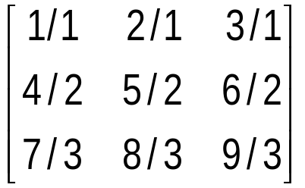
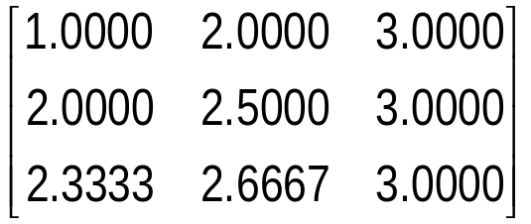
Vectors and Matrices
Arithmetic operations – Matrices
Performing operations between matrices
A/B
? (matrices singular)
A./B
=

Slide 21
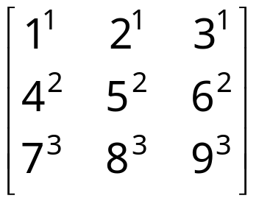
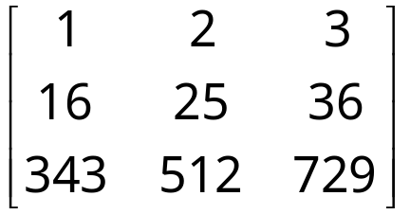
Vectors and Matrices
Arithmetic operations – Matrices
Performing operations between matrices
A^B
??? Error using ==> ^
At least one operand must be scalar
A.^B
=

Slide 22
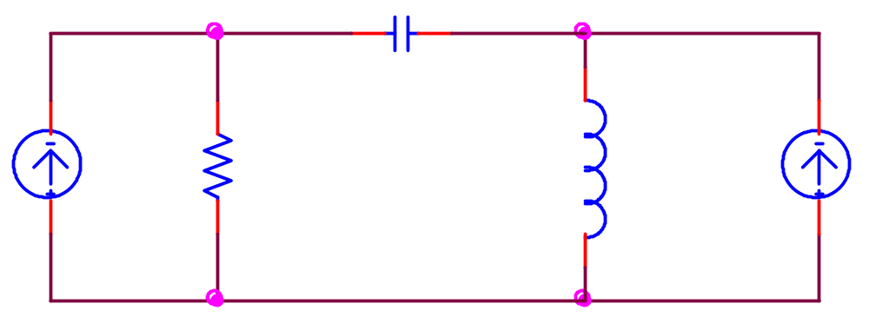
Vectors and Matrices
Arithmetic operations – Matrices
Example:
-j5Ω
j10Ω
2∠-90º
10Ω
1.5∠0º
Solve for V₁ and V₂

Slide 23
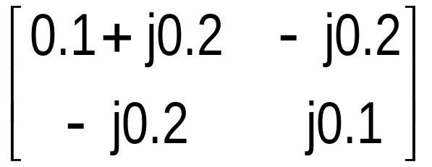
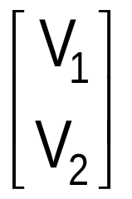
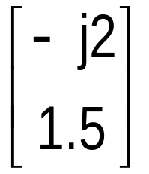
Vectors and Matrices
Arithmetic operations – Matrices
Example (cont)
(0.1 + j0.2)V₁ – j0.2V₂ = -j2
- j0.2V₁ + j0.1V₂ = 1.5
=
A
x
=
y

Slide 24
Vectors and Matrices
Arithmetic operations – Matrices
Example (cont)
>>> A=[(0.1+0.2j) -0.2j;-0.2j 0.1j]
A =
0.1000+ 0.2000i 0- 0.2000i
0- 0.2000i 0+ 0.1000i
>>> y=[-2j;1.5]
y =
0- 2.0000i
1.5000
>>> x=A\y
x =
14.0000+ 8.0000i
28.0000+ 1.0000i
>>>
* A\B is the matrix division of A into B, which is roughly the same as INV(A)*B *

Slide 25
Vectors and Matrices
Arithmetic operations – Matrices
Example (cont)
>>> V1= abs(x(1,:))
V1 =
16.1245
>>> V1ang= angle(x(1,:))
V1ang =
0.5191
V₁ = 16.12∠29.7º V

Slide 26
Built in functions
(commands)
Scalar functions – used for scalars and operate element-wise when applied to a matrix or vector
e.g. sin cos tan atan asin log
abs angle sqrt round floor
At any time you can use the command help to get help
e.g. >>>help sin

Slide 27
Built in functions (commands)
>>> a=linspace(0,(2*pi),10)
a =
Columns 1 through 7
0 0.6981 1.3963 2.0944 2.7925 3.4907 4.1888
Columns 8 through 10
4.8869 5.5851 6.2832
>>> b=sin(a)
b =
Columns 1 through 7
0 0.6428 0.9848 0.8660 0.3420 -0.3420 -0.8660
Columns 8 through 10
-0.9848 -0.6428 0.0000
>>>

Slide 28
Built in functions (commands)
Vector functions – operate on vectors returning scalar value
e.g. max min mean prod sum length
>>> max(b)
ans =
0.9848
>>> max(a)
ans =
6.2832
>>> length(a)
ans =
10
>>>
>>> a=linspace(0,(2*pi),10);
>>> b=sin(a);

Slide 29
Built in functions (commands)
Matrix functions – perform operations on matrices
>>> help elmat
>>> help matfun
e.g. eye size inv det eig
At any time you can use the command help to get help

Slide 30
Built in functions (commands)
Matrix functions – perform operations on matrices
>>> x=rand(4,4)
x =
0.9501 0.8913 0.8214 0.9218
0.2311 0.7621 0.4447 0.7382
0.6068 0.4565 0.6154 0.1763
0.4860 0.0185 0.7919 0.4057
>>> xinv=inv(x)
xinv =
2.2631 -2.3495 -0.4696 -0.6631
-0.7620 1.2122 1.7041 -1.2146
-2.0408 1.4228 1.5538 1.3730
1.3075 -0.0183 -2.5483 0.6344
>>> x*xinv
ans =
1.0000 0.0000 0.0000 0.0000
0 1.0000 0 0.0000
0.0000 0 1.0000 0.0000
0 0 0.0000 1.0000
>>>

Slide 31
Built in functions (commands)
From our previous example,
=
x
y
A
=
>>> x=inv(A)*y
x =
14.0000+ 8.0000i
28.0000+ 1.0000i

Slide 32
Built in functions (commands)
Data visualisation – plotting graphs
>>> help graph2d
>>> help graph3d
e.g. plot polar loglog mesh
semilog plotyy surf

Slide 33
Built in functions (commands)
eg1_plt.m
Data visualisation – plotting graphs
Example on plot – 2 dimensional plot
Example on plot – 2 dimensional plot
>>> x=linspace(0,(2*pi),100);
>>> y1=sin(x);
>>> y2=cos(x);
Add title, labels and legend
>>> plot(x,y1,'r-')
>>> hold
Current plot held
>>> plot(x,y2,'g--')
>>>
title xlabel ylabel legend
Use ‘copy’ and ‘paste’ to add to your window–based document, e.g. MSword

Slide 34
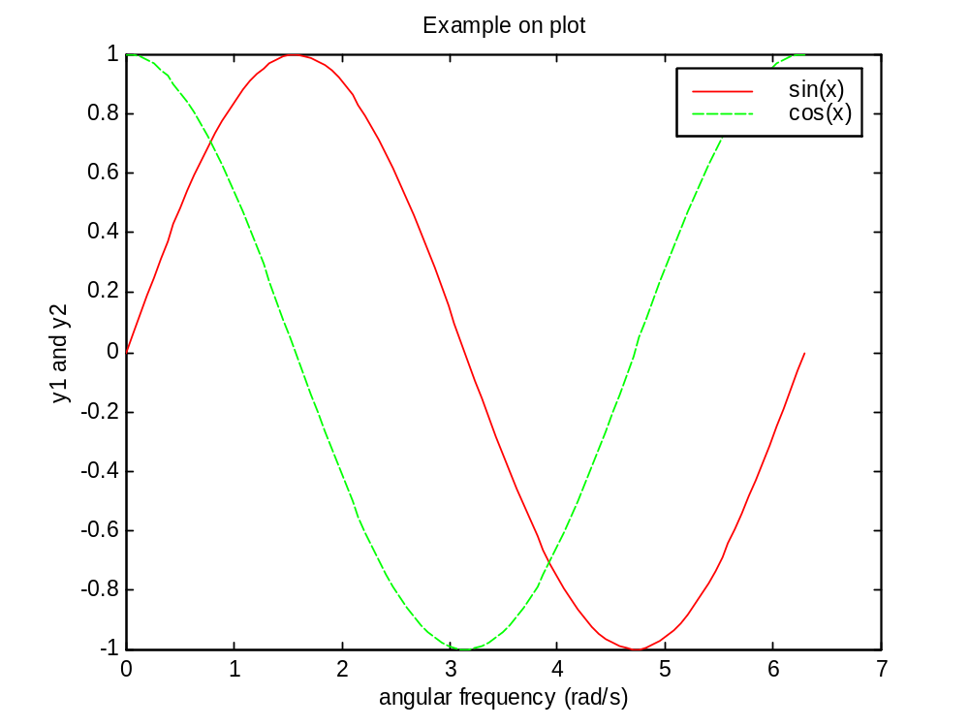
Built in functions (commands)
eg1_plt.m
Data visualisation – plotting graphs
Example on plot – 2 dimensional plot

Slide 35
Built in functions (commands)
eg2_srf.m
Data visualisation – plotting graphs
Example on mesh and surf – 3 dimensional plot
Supposed we want to visualize a function
Z = 10e^{(–0.4a)} sin (2πft) for f = 2
when a and t are varied from 0.1 to 7 and 0.1 to 2, respectively
>>> [t,a] = meshgrid(0.1:.01:2, 0.1:0.5:7);
>>> f=2;
>>> Z = 10.*exp(-a.*0.4).*sin(2*pi.*t.*f);
>>> surf(Z);
>>> figure(2);
>>> mesh(Z);

Slide 36
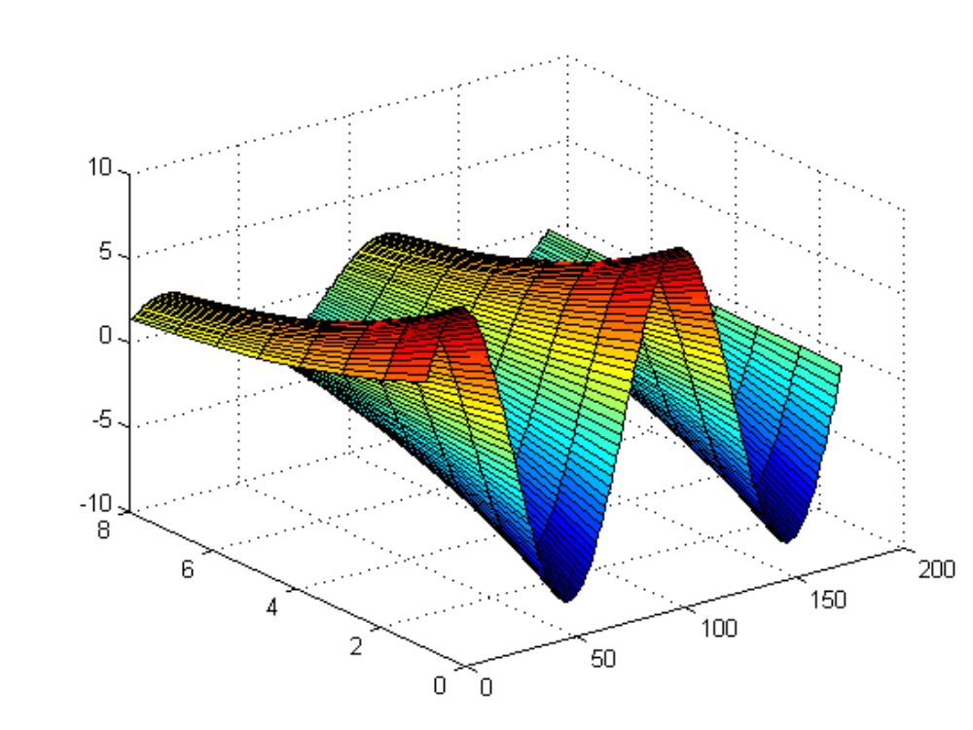
Built in functions (commands)
eg2_srf.m
Data visualisation – plotting graphs
Example on mesh and surf – 3 dimensional plot

Slide 37
Built in functions (commands)
eg3_srf.m
Data visualisation – plotting graphs
Example on mesh and surf – 3 dimensional plot
>>> [x,y] = meshgrid(-3:.1:3,-3:.1:3);
>>> z = 3*(1-x).^2.*exp(-(x.^2) - (y+1).^2) ...
- 10*(x/5 - x.^3 - y.^5).*exp(-x.^2-y.^2) ...
- 1/3*exp(-(x+1).^2 - y.^2);
>>> surf(z);

Slide 38
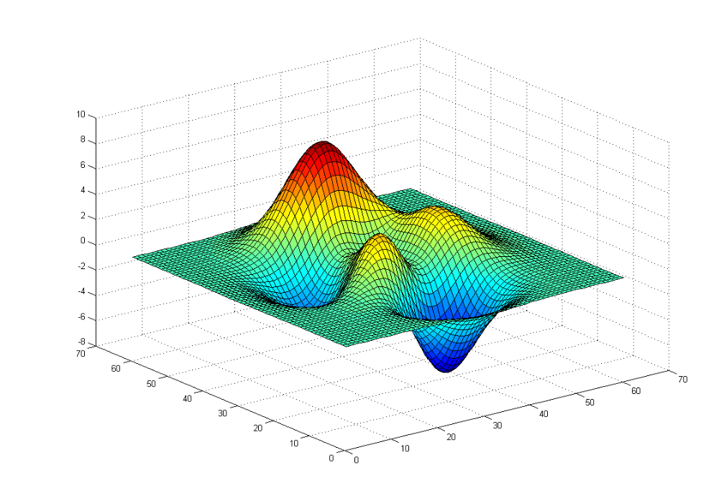
Built in functions (commands)
eg2_srf.m
Data visualisation – plotting graphs
Example on mesh and surf – 3 dimensional plot

Slide 39
M-files :
Script and function files
When problems become complicated and require re–evaluation, entering command at MATLAB prompt is not practical
Solution : use M-files
Script
Function
Collections of commands
User defined commands
Executed in sequence when called
Normally has input & output
Saved with extension “.m”
Saved with extension “.m”

Slide 40
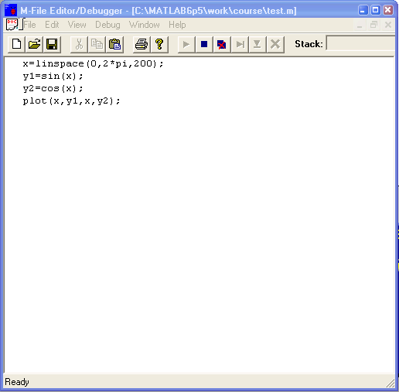
M-files : script and function files (script)
eg1_plt.m
At Matlab prompt type in edit to invoke M-file editor
Save this file as test1.m

Slide 41
M-files : script and function files (script)
To run the M-file, type in the name of the file at the prompt e.g. >>> test1
It will be executed provided that the saved file is in the known path
Type in matlabpath to check the list of directories listed in the path
Use path editor to add the path: File → Set path …

Slide 42
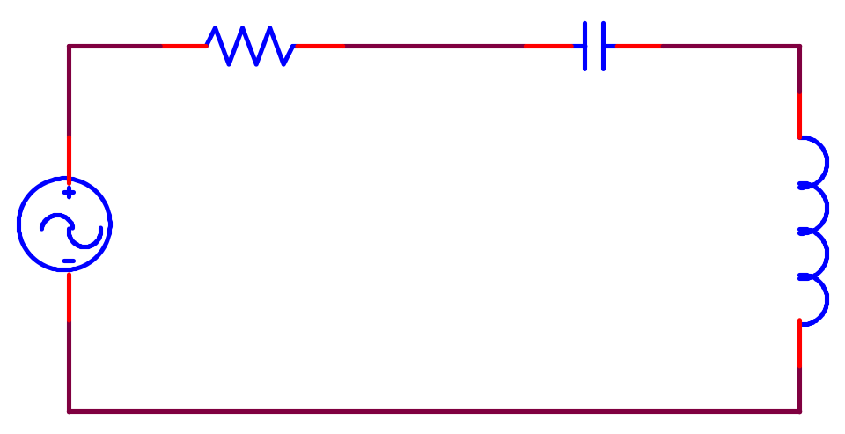
M-files : script and function files (script)
eg4.m
eg5_exercise1.m
Example – RLC circuit
R = 10Ω
C
+
V
–
L
Exercise 1:
Write an m–file to plot Z, X_{c} and X_{L}versus frequency for R =10, C = 100 uF, L = 0.01 H.

Slide 43
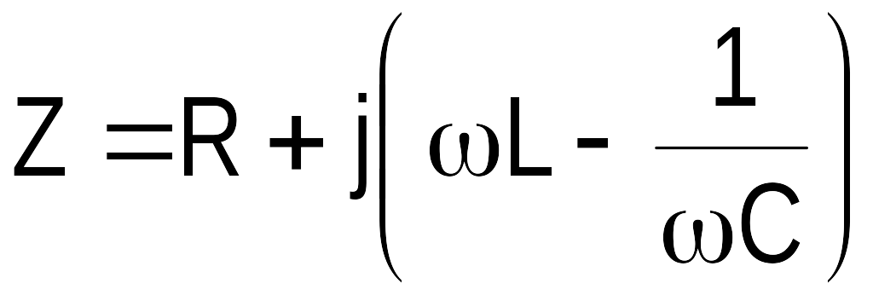

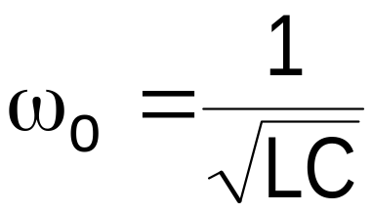
M-files : script and function files (script)
Example – RLC circuit
Total impedance is given by:
When

Slide 44
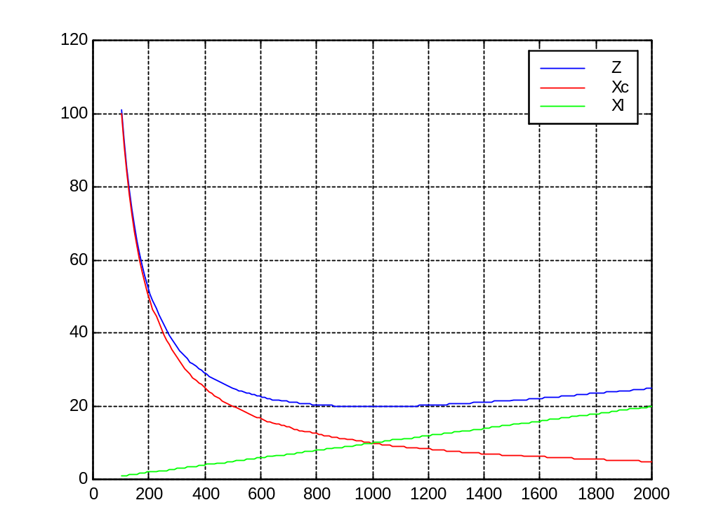
M-files : script and function files (script)
eg4.m
eg5_exercise1.m
Example – RLC circuit

Slide 45
M-files : script and function files (script)
eg6.m
Example – RLC circuit
R = 10Ω
C
+
V
–
L
For a given values of C and L, plot the following versus the frequency
a) the total impedance ,
X_{c} and X_{L}
phase angle of the total impedance
for 100 < ω < 2000

Slide 46
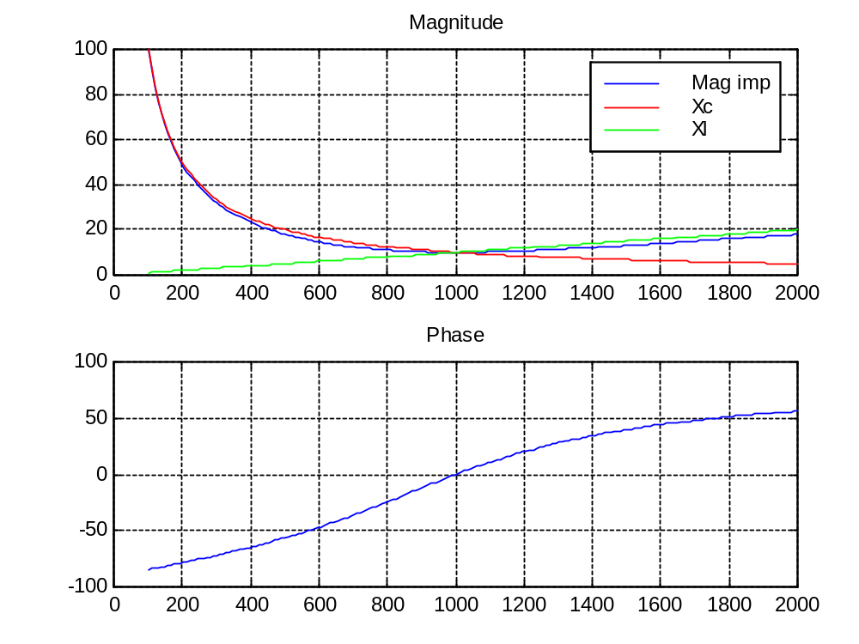
M-files : script and function files (script)
eg6.m
Example – RLC circuit

Slide 47
M-files : script and function files (function)
Function is a ‘black box’ that communicates with workspace through input and output variables.
INPUT
OUTPUT
FUNCTION
– Commands
– Functions
– Intermediate variables

Slide 48
M-files : script and function files (function)
Every function must begin with a header:
function output=function_name(inputs)
Output variable
Must match the file name
input variable

Slide 49
M-files : script and function files (function)
Function – a simple example
function y=react_C(c,f)
%react_C calculates the reactance of a capacitor.
%The inputs are: capacitor value and frequency in hz
%The output is 1/(wC) and angular frequency in rad/s
y(1)=2*pi*f;
w=y(1);
y(2)=1/(w*c);
File must be saved to a known path with filename the same as the function name and with an extension ‘.m’
Call function by its name and arguments
help react_C will display comments after the header

Slide 50
M-files : script and function files (function)
impedance.m
Function – a more realistic example
function x=impedance(r,c,l,w)
%IMPEDANCE calculates Xc,Xl and Z(magnitude) and %Z(angle) of the RLC connected in series
%IMPEDANCE(R,C,L,W) returns Xc, Xl and Z (mag) and %Z(angle) at W rad/s
%Used as an example for IEEE student, UTM %introductory course on MATLAB
if nargin <4
error('not enough input arguments')
end;
x(1) = 1/(w*c);
x(2) = w*l;
Zt = r + (x(2) - x(1))*i;
x(3) = abs(Zt);
x(4)= angle(Zt);

Slide 51
M-files : script and function files (function)
eg7_fun.m
We can now add our function to a script M-file
R=input('Enter R: ');
C=input('Enter C: ');
L=input('Enter L: ');
w=input('Enter w: ');
y=impedance(R,C,L,w);
fprintf('\n The magnitude of the impedance at %.1f rad/s is %.3f ohm\n', w,y(3));
fprintf('\n The angle of the impedance at %.1f rad/s is %.3f degrees\n\n', w,y(4));

Slide 52
Simulink
Used to model, analyze and simulate dynamic systems using block diagrams.
Provides a graphical user interface for constructing block diagram of a system – therefore is easy to use.
However modeling a system is not necessarily easy !

Slide 53
Simulink
Model – simplified representation of a system – e.g. using mathematical equation
We simulate a model to study the behavior of a system – need to verify that our model is correct – expect results
Knowing how to use Simulink or MATLAB does not mean that you know how to model a system

Slide 54
Simulink
Problem: We need to simulate the resonant circuit and display the current waveform as we change the frequency dynamically.
i
10 Ω
100 uF
Varies ω from 0 to 2000 rad/s
+
v(t) = 5 sin ωt
–
0.01 H
Observe the current. What do we expect ?
The amplitude of the current waveform will become maximum at resonant frequency, i.e. at ω = 1000 rad/s

Slide 55
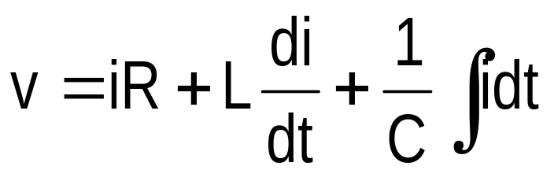
Simulink
How to model our resonant circuit ?
i
10 Ω
100 uF
+
v(t) = 5 sin ωt
–
0.01 H
Writing KVL around the loop,

Slide 56
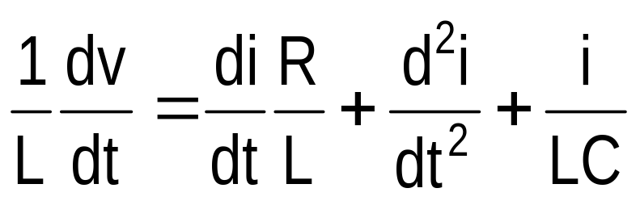
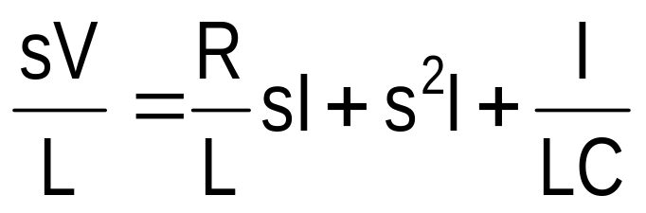
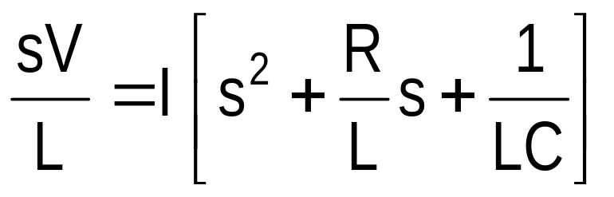
Simulink
Differentiate wrt time and re-arrange:
Taking Laplace transform:

Slide 57
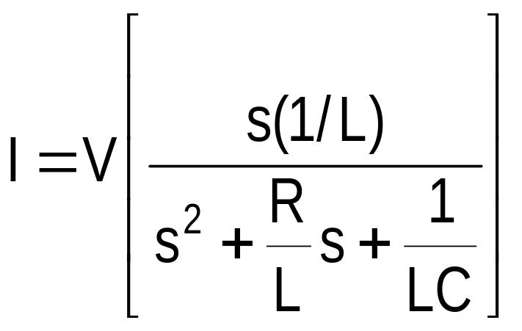
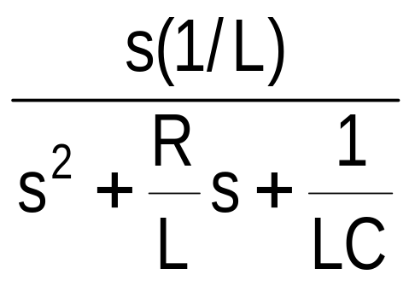
Simulink
Thus the current can be obtained from the voltage:
V
I

Slide 58
Simulink
Start Simulink by typing simulink at Matlab prompt
Simulink library and untitled windows appear
It is where we obtain the blocks to construct our model
It is here where we construct our model.

Slide 59
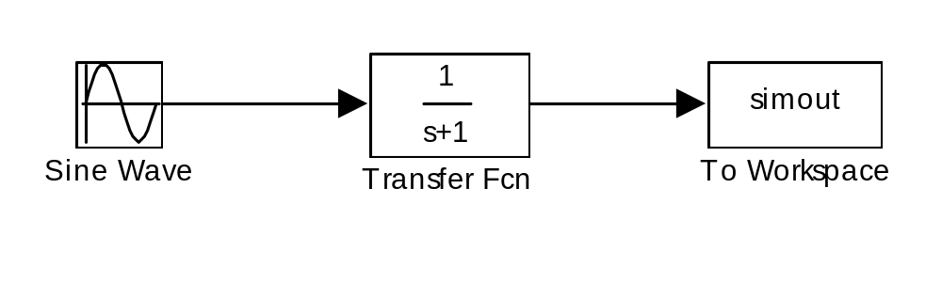
Simulink
Constructing the model using Simulink:
‘Drag and drop’ block from the Simulink library window to the untitled window

Slide 60
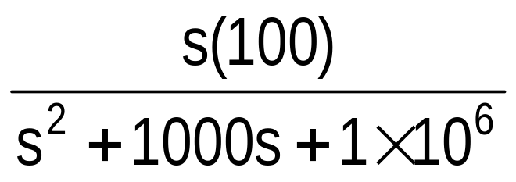
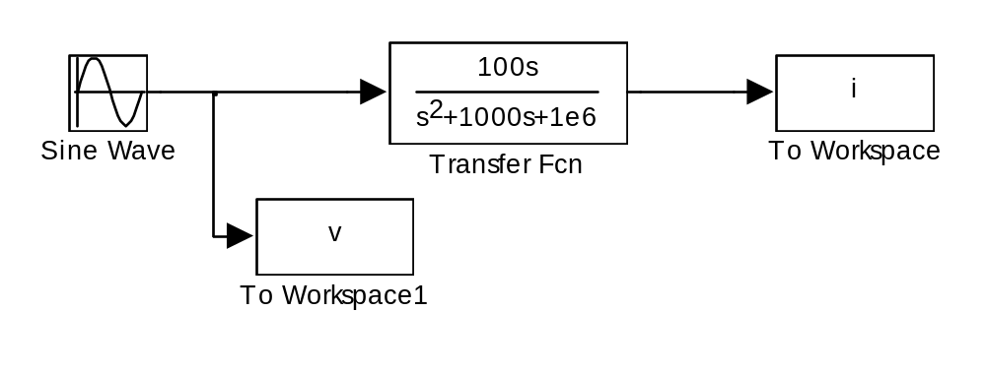
Simulink
Constructing the model using Simulink:

Slide 61
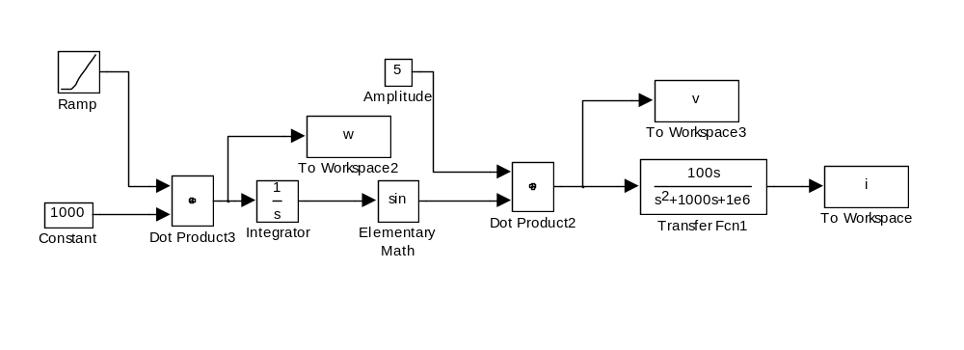
Simulink
eg8_sim.mdl
We need to vary the frequency and observe the current
…From initial problem definition, the input is 5sin(ωt).
You should be able to decipher why the input works, but you do not need to create your own input subsystems of this form.

Slide 62
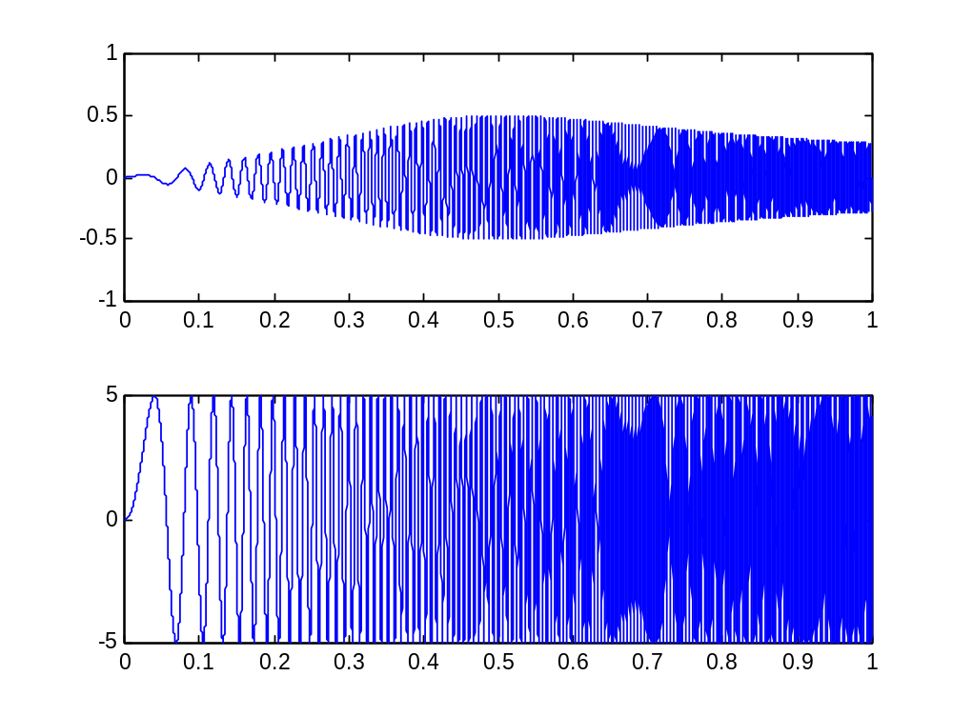
Simulink

Slide 63
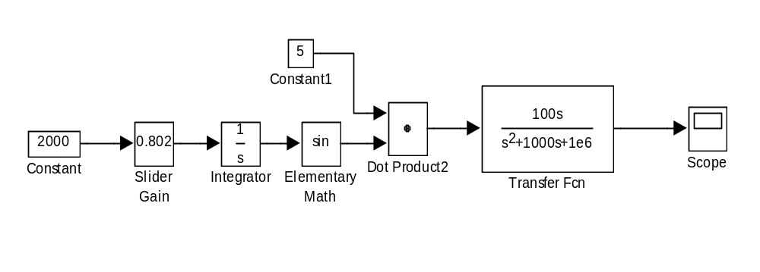
Simulink
eg9_sim.mdl
The waveform can be displayed using scope – similar to the scope in the lab

Slide 64
Reference
Internet – search engine
Mastering MATLAB 6 (Prentice Hall)
  Duane Hanselman
  Bruce Littlefield

